Slide 1

GaN/AlGaN heterostructure
2DEG Length $1 μm$
Simulated Frequency 25 THz

Slide 2
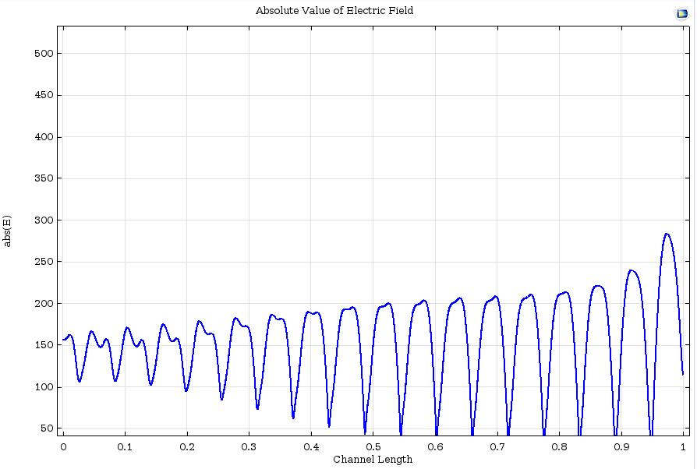
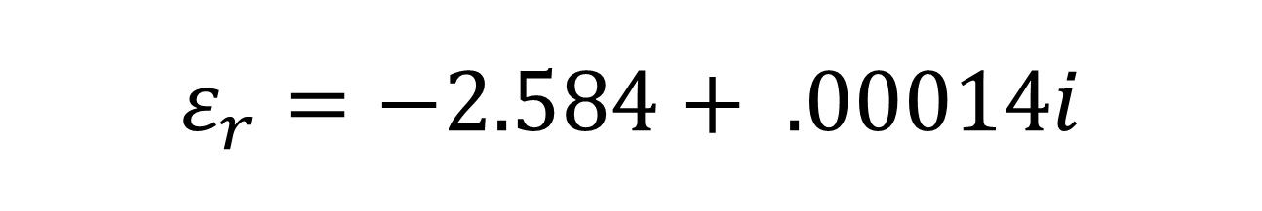
$$ε_{r}=−2.584+ .00014i$$

Slide 3
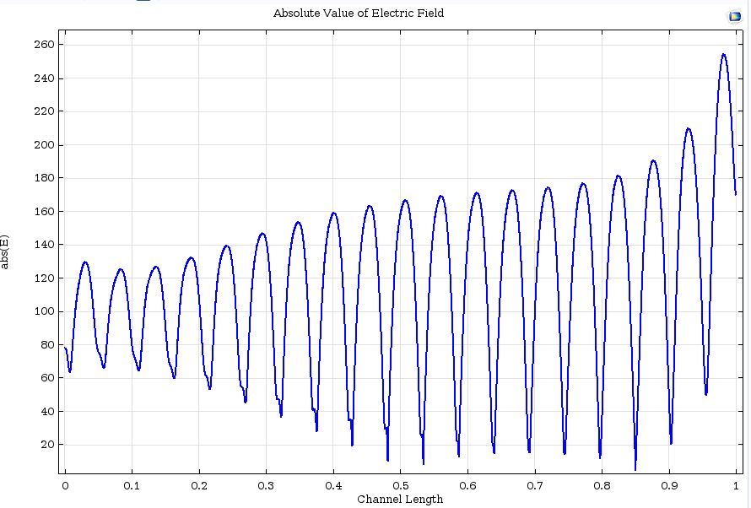
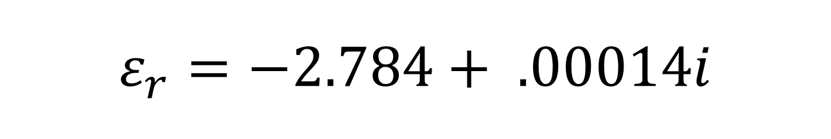
$$ε_{r}=−2.784+ .00014i$$

Slide 4
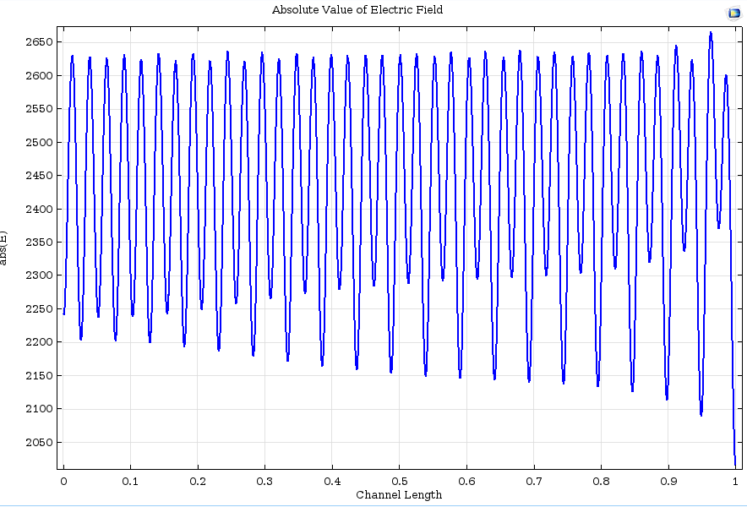

$$ε_{r}=−2.88+ .00014i$$

Slide 5
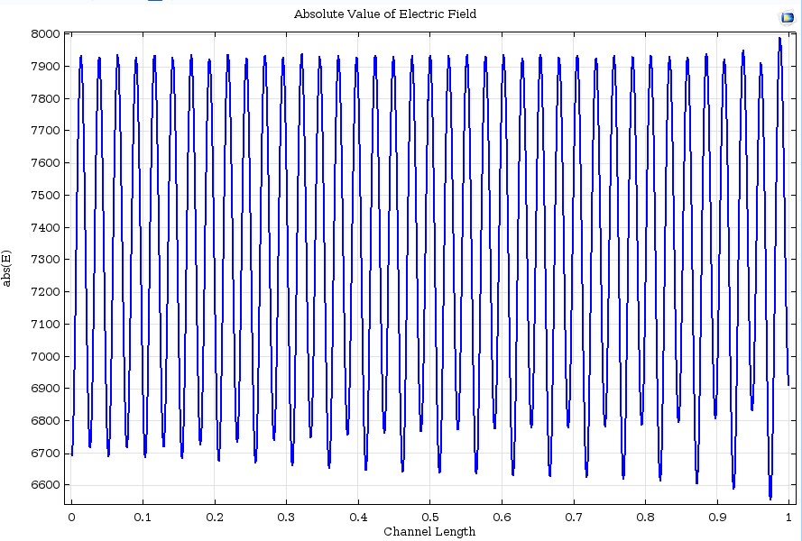
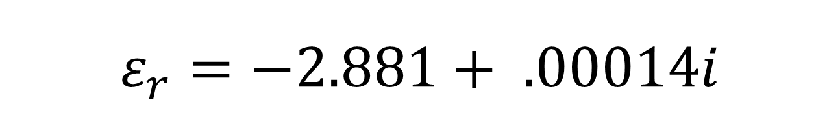
$$ε_{r}=−2.881+ .00014i$$

Slide 6
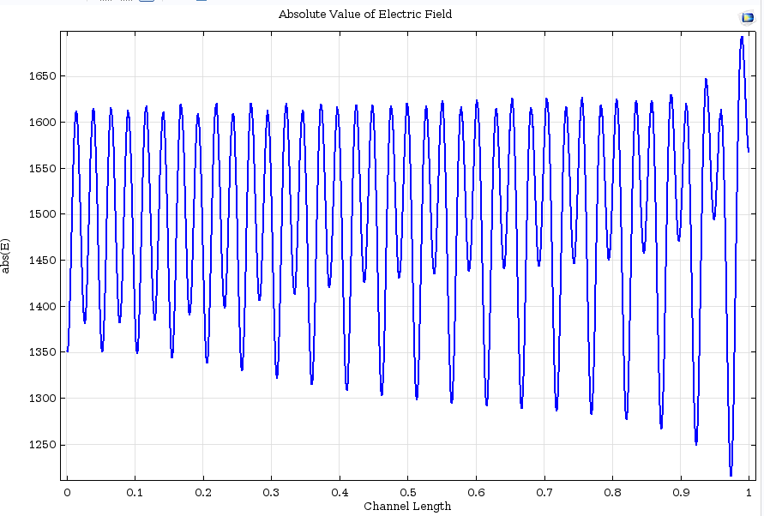
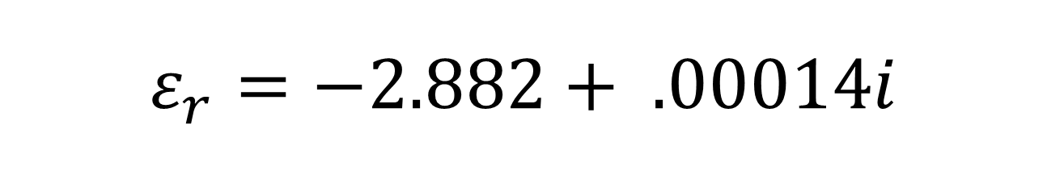
$$ε_{r}=−2.882+ .00014i$$

Slide 7
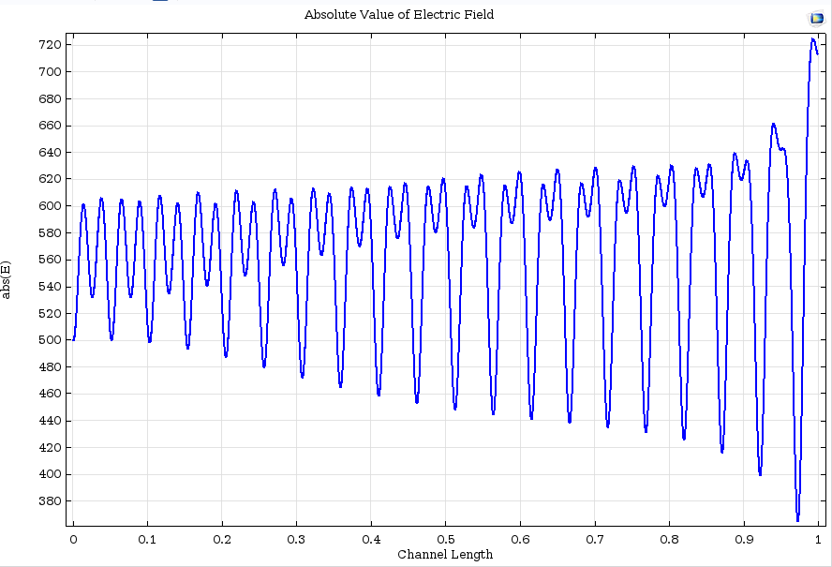
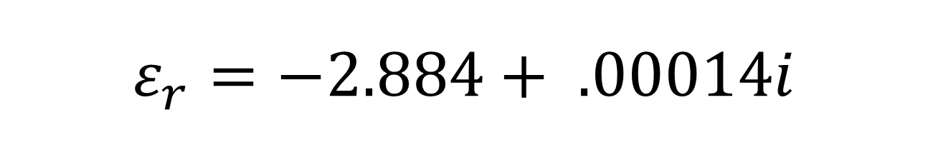
$$ε_{r}=−2.884+ .00014i$$

Slide 8
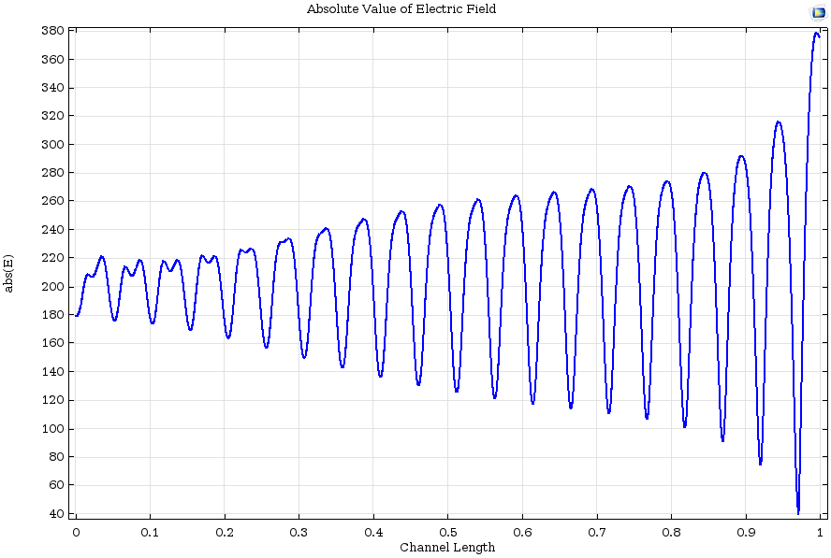

$$ε_{r}=−2.89+ .00014i$$

Slide 9
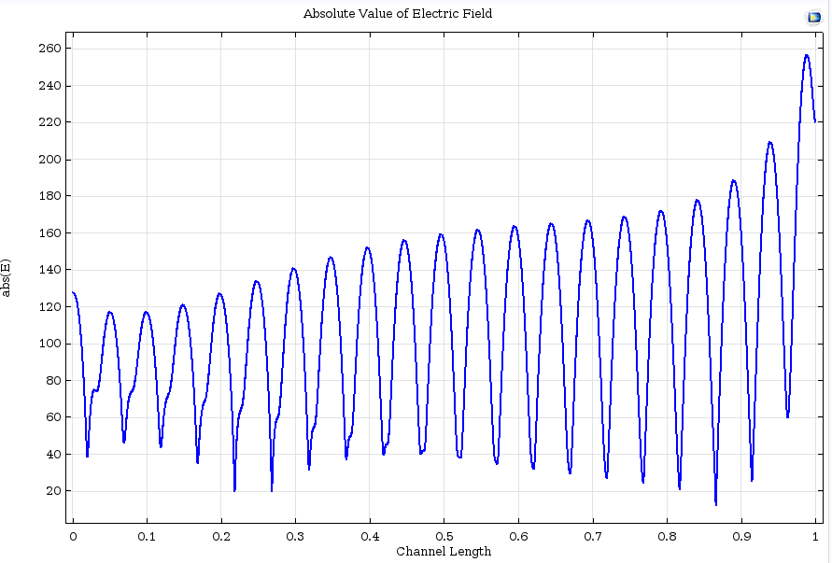
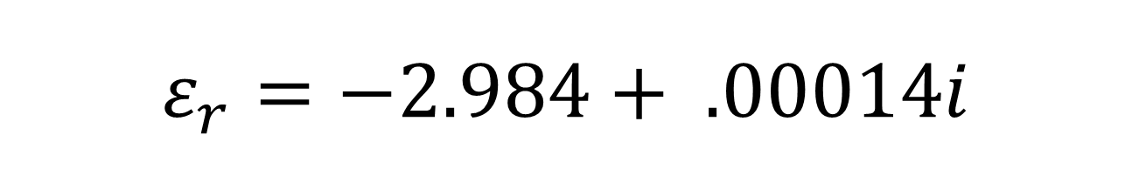
$$ε_{r}=−2.984+ .00014i$$

Slide 10
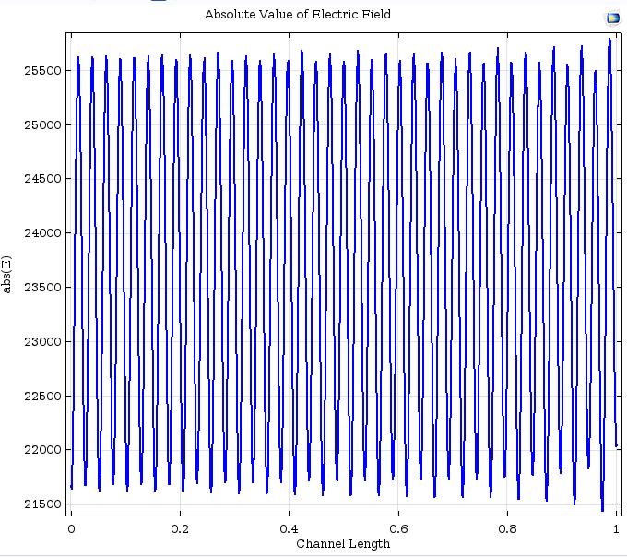
$$ε_{r}=−2.881+ .00014i$$
Extra Plane wave source with E-field polarization along the 2DEG.

Slide 11
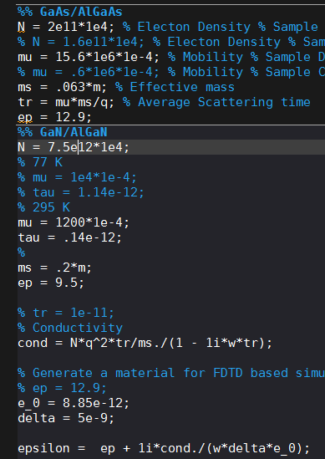
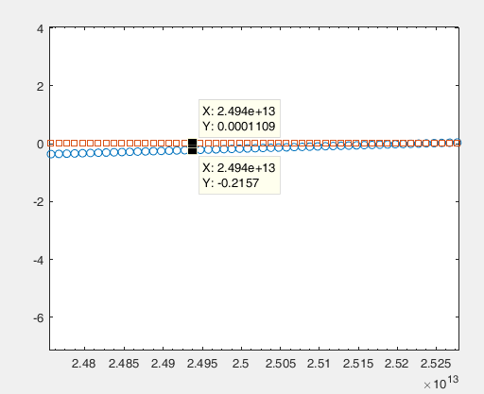
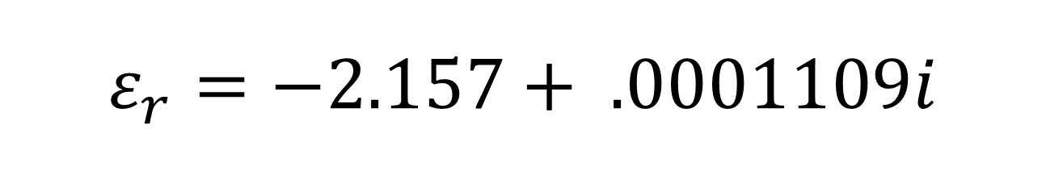
$$ε_{r}=−2.157+ .0001109i$$
Extra Plane wave source with E-field polarization along the 2DEG.

